Slide 1
Chapter 1
An Introduction to Computer Science

Slide 2
Learning Objectives
Understand the definition of the term algorithm
Understand the formal definition of computer science
Write down everyday algorithms
Determine if an algorithm is ambiguous or not effectively computable
Understand the roots of modern computer science in mathematics and mechanical machines
Summarize the key points in the historical development of modern electronic computers

Slide 3
Introduction
Common misconceptions about computer science:
Computer science is the study of computers.
Computer science is the study of how to write computer programs.
Computer science is the study of the uses and applications of computers and software.

Slide 4
The Definition of Computer Science (1 of 4)
Computer science is the study of algorithms, including:
Their formal and mathematical properties
Their hardware realizations
Their linguistic realizations
Their applications

Slide 5
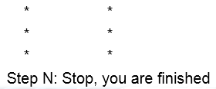
The Definition of Computer Science (2 of 4)
The informal definition of an algorithm:
An ordered sequence of instructions that is guaranteed to solve a specific problem. For example:
Step 1: Do something
Step 2: Do something
Step 3: Do something

Slide 6
The Definition of Computer Science (3 of 4)
Operations used to construct algorithms:
Sequential operations
Carries out a single well-defined task
Conditional operations
Ask a question and the next operation is then selected on the basis of the answer to that question
Iterative operations
Looping instructions that tell not to go on but go back and repeat the execution of a previous block of instructions

Slide 7
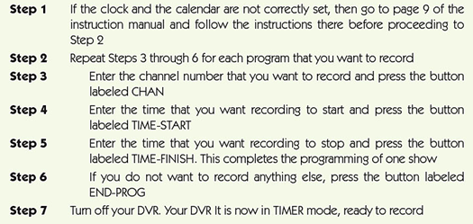
Figure 1.1 Programming your DVR: An example of an algorithm

Slide 8
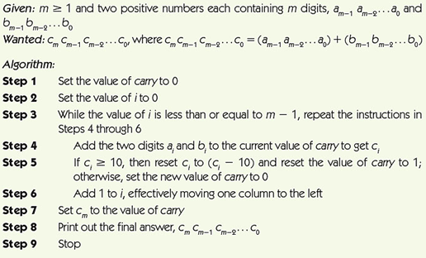
Figure 1.2 Algorithm for adding two m-digit numbers

Slide 9
The Definition of Computer Science (4 of 4)
Why are formal algorithms so important in computer science?
If we can specify an algorithm to solve a problem, then we can automate its solution
Computing agent
Machine, robot, person, or thing carrying out the steps of the algorithm
Unsolved problems
Some problems are unsolvable, some solutions are too slow, and some solutions are not yet known

Slide 10
Algorithms (1 of 5)
The Formal Definition of an Algorithm:
A well-ordered collection of unambiguous and effectively computable operations that, when executed, produces a result and halts in a finite amount of time

Slide 11
Algorithms (2 of 5)
Well-ordered collection
Upon completion of an operation, we always know which operation to do next
Unambiguous and effectively computable operations
It is not enough for an operation to be understandable, it must also be doable (effectively computable)
Ambiguous statements
Go back and do it again (Do what again?)
Start over (From where?)

Slide 12
Algorithms (3 of 5)
Produces a result and halts in a finite amount of time
To know whether a solution is correct, an algorithm must produce a result that is observable to a user:
A numerical answer
A new object
A change in the environment

Slide 13
Algorithms (4 of 5)
Unambiguous operation, or primitive
Can be understood by the computing agent without having to be further defined or simplified
It is not enough for an operation to be understandable
It must also be doable (effectively computable) by the computing agent
Infinite loop
Runs forever
Usually a mistake

Slide 14
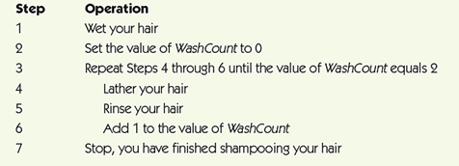
Figure 1.3 A correct solution to the shampooing problem

Slide 15
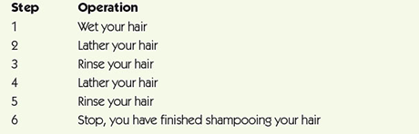
Figure 1.4 Another correct solution to the shampooing problem

Slide 16
Algorithms (5 of 5)
The Importance of Algorithmic Problem Solving
“Industrial revolution” of the nineteenth century
Mechanized and automated repetitive physical tasks
“Computer revolution” of the twentieth and twenty-first centuries
Mechanized and automated repetitive mental tasks
Used algorithms and computer hardware

Slide 17
A Brief History of Computing The Early Period: Up to 1940 (1 of 7)
Seventeenth century: automation/simplification of arithmetic for scientific research:
John Napier invented logarithms as a way to simplify difficult mathematical computations (1614).
The first slide rule appeared around 1622.
Blaise Pascal designed and built a mechanical calculator named the Pascaline (1642).
Gottfried Leibnitz constructed a mechanical calculator called Leibnitz’s Wheel (1673).

Slide 18
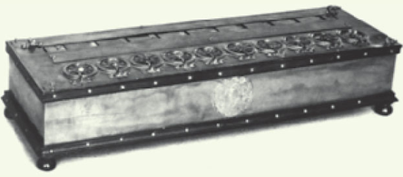
Figure 1.5 The pascaline, one of the earliest mechanical calculators
Source: INTERFOTO/Alamy

Slide 19
A Brief History of Computing The Early Period: Up to 1940 (2 of 7)
Seventeenth century devices:
Could represent numbers
Could perform arithmetic operations on numbers
Did not have a memory to store information
Were not programmable (a user could not provide a sequence of actions to be executed by the device)

Slide 20
A Brief History of Computing The Early Period: Up to 1940 (3 of 7)
Nineteenth-century devices:
Joseph Jacquard designed an automated loom that used punched cards to create patterns (1801)
Herman Hollerith (1880s onward)
Designed and built programmable card-processing machines to read, tally, and sort data on punched cards for the U.S. Census Bureau
Founded a company that became IBM in 1924

Slide 21
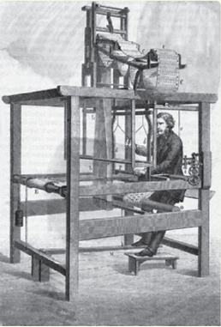
Figure 1.6 Drawing of the Jacquard loom
Source: © Bettmann/CORBIS

Slide 22
A Brief History of Computing The Early Period: Up to 1940 (4 of 7)
Luddites
Originally opposed to the new manufacturing technology introduced by the Jacquard Loom
Now a term used to describe any group that is frightened or angered by the latest developments in any branch of science and technology, including computers

Slide 23
A Brief History of Computing The Early Period: Up to 1940 (5 of 7)
Charles Babbage
Difference Engine designed and built in 1823
Could do addition, subtraction, multiplication, and division to six significant digits
Could solve polynomial equations and other complex mathematical problems

Slide 24
A Brief History of Computing The Early Period: Up to 1940 (6 of 7)
Charles Babbage
Analytical Engine
Designed but never built
Mechanical, programmable machine with parts that mirror that of a modern-day computer:
Mill: Arithmetic/logic unit
Store: Memory
Operator: Processor
Output Unit: Input/Output

Slide 25
A Brief History of Computing The Early Period: Up to 1940 (7 of 7)
Nineteenth-century devices:
Were mechanical, not electrical
Had many features of modern computers:
Representation of numbers or other data
Operations to manipulate the data
Memory to store values in a machine-readable form
Programmable: sequences of instructions could be predesigned for complex operations

Slide 26
A Brief History of Computing The Birth of Computers: 1940–1950 (1 of 5)
Mark I (1944)
Electromechanical computer used a mix of relays, magnets, and gears to process and store data
Colossus (1943)
General-purpose computer built by Alan Turing for the British Enigma project
ENIAC (Electronic Numerical Integrator and Calculator) (1946)
First publicly known fully electronic computer

Slide 27
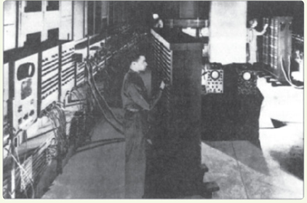
Figure 1.7 Photograph of the ENIAC computer
Source: From the Collections of the University of Pennsylvania Archives (U.S Army photo)

Slide 28
A Brief History of Computing The Birth of Computers: 1940–1950 (2 of 5)
John Von Neumann
Proposed a radically different computer design based on a model called the stored program computer
Research group at the University of Pennsylvania built one of the first stored program computers, called EDVAC, in 1949
UNIVAC I, a version of EDVAC, the first commercially sold computer
Nearly all modern computers use the Von Neumann architecture

Slide 29
A Brief History of Computing The Modern Era: 1950 to the Present (3 of 5)
First generation of computing (1950–1957)
Similar to EDVAC
Vacuum tubes for processing and storage
Large, expensive, and delicate
Required trained users and special environments
Second generation (1957–1965)
Transistors and magnetic cores instead of vacuum tubes
Era of FORTRAN and COBOL: some of the first high-level programming languages

Slide 30
A Brief History of Computing The Modern Era: 1950 to the Present (4 of 5)
Third generation (1965–1975)
Era of the integrated circuit
Birth of the first minicomputer: desk-sized, not room-sized, computers
Birth of the software industry
Fourth generation (1975–1985)
The first microcomputer: desktop machine
Development of widespread computer networks
Electronic mail, graphical user interfaces, and embedded systems

Slide 31
A Brief History of Computing The Modern Era: 1950 to the Present (5 of 5)
Fifth generation (1985–?)
Massively parallel processors capable of quadrillions (10¹⁵) of computations per second
Handheld digital devices
Powerful multimedia user interfaces incorporating sound, voice recognition, video, and television
Wireless communications
Massive cloud storage devices
Ubiquitous computing
Ultra-high-resolution graphics and virtual reality

Slide 32
Organization of the Text
Computer science is the study of algorithms, including: | Levels of the text:
Their formal and mathematical properties | Level 1: The Algorithmic Foundations of Computer Science
Their hardware realizations | Level 2: The Hardware World Level 3: The Virtual Machine
Their linguistic realizations | Level 4: The Software World
Their applications | Level 5: Applications Level 6: Social Issues

Slide 33
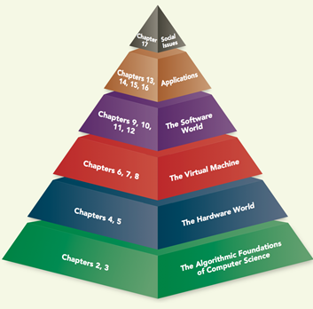
Figure 1.9 Organization of the Text into a six-layer hierarchy

Slide 34
Summary
Computer science is the study of algorithms.
An algorithm is a well-ordered collection of unambiguous and effectively computable operations that, when executed, produces a result and halts in a finite amount of time.
If we can specify an algorithm to solve a problem, then we can automate its solution.
Computers developed from mechanical calculating devices to modern electronic marvels of miniaturization.

